Slide 1
Binary Multiplication

Slide 2
Some general observations
Multiplication involves the generation of partial products – one for each digit in the multiplier.
Partial products are summed to produce the final product.
Partial products are very simple to define for binary multiplication. If the digit is a ‘one’ the partial product is the multicand, otherwise the partial product is zero.
The total product is the sum of the partial products. Each successive partial product is shifted one position to the left.
The multiplication of two n-bit binary numbers results in a product of up to 2n bits in length.

Slide 3
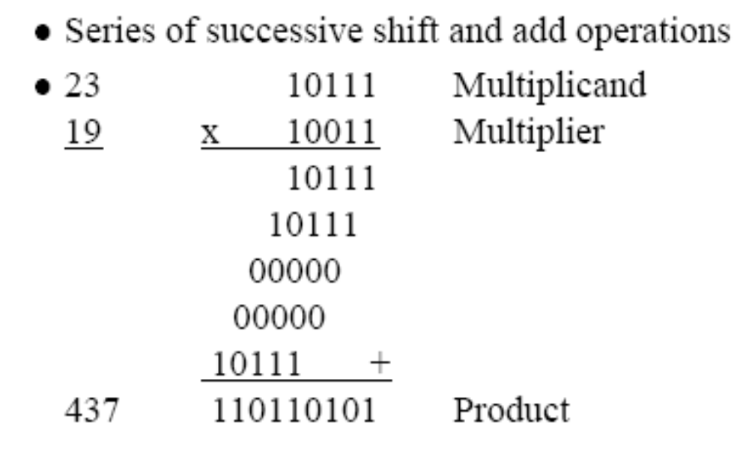
1011
X 1101
1011
0000
1011
1011
10001111
1 0 0 0 _{two} = 8₍₁₀₎ multiplicand
1 0 0 1 _{two} = 9₍₁₀₎ multiplier
____________
1 0 0 0
0 0 0 0 partial products
0 0 0 0
1 0 0 0
____________
1 0 0 1 0 0 0_{two} = 72₍₁₀₎

Slide 4
Simplifying Multiplication
The processor can keep a running product rather than summing at the end.
For each ‘1’ in the multiplier we can apply an add and a shift.
For each ‘0’ only a shift is needed.

Slide 5
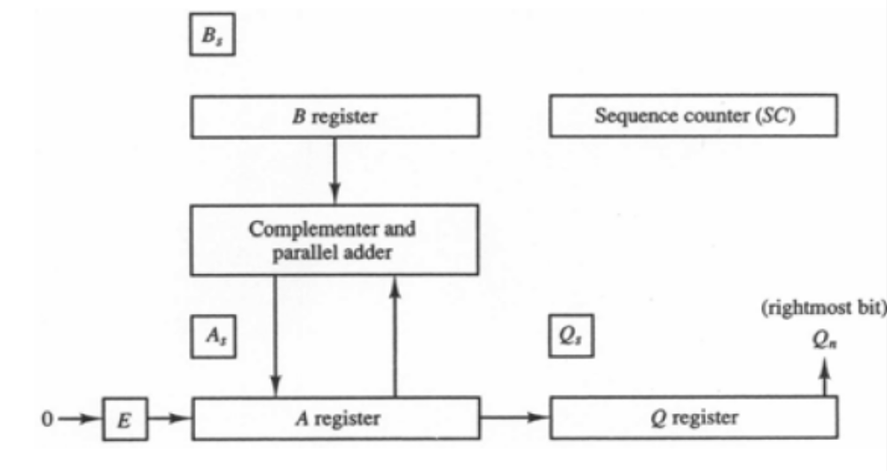
Hardware Implementation for Signed-Magnitude Multiplication

Slide 6
Description
Q multiplier
B multiplicand
A 0
SC number of bits in multiplier
E overflow bit for A
Do SC times
  If low-order bit of Q is 1
    A ← A + B
  Shift right EAQ
Product is in AQ

Slide 7
Flow chart for Multiplication (Signed Magnitude Representation)
Multiply Operation
23 × 19 = 437
Q = 19 (10011), B = 23 (10111)
Multiplicand in B
Multiplier in Q
E
A
Q
SC
A_{S} ← Q_{S} + B_{S}
Q_{S} ← Q_{S} + B_{S}
A ← 0, E ← 0
SC ← n – 1
0
00000
10011
101
Add
10111
10111
Shift
0
01011
11001
100
Add
10111
= 0
Q_{n}
= 1
1
00010
Shift
0
10001
01100
011
EA ← A + B
Shift
0
01000
10110
010
Shr EAQ
SC ← SC – 1
Shift
0
00100
01011
001
Add
10111
≠ 0
= 0
11011
SC
Shift
0
01101
10101
000
END
(Product is in AQ)

Slide 8
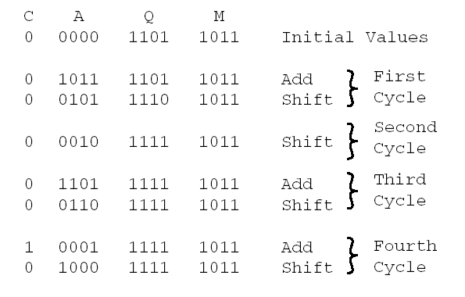
Example: 11 × 13
E
Group Exercise:
Group 1: 3 X 7, Group 2: -3 X 7, Group 3: 3 X -7, Group 4: -3 X -7

Slide 9
Exercise
Show the contents of registers E, A, Q and SC during the process of multiplication of two binary numbers, 11111 (multiplicand) and 10101 (multiplier). The signs are not included.

Slide 10
Observation
M X (00011110) = M X (2⁴ + 2³ +2² + 2¹)
= M X (16 + 8 + 4 + 2)
= M X 30
The number of operations can be reduced to two if we observe that:
2^{n} + 2^{n-1} + …. + 2^{n-k} = 2^{n+1} – 2^{n-k}
M X (00011110) = M X (2⁵ - 2¹)
= M X (32 - 2)
= M X 30
14 = 01110 = 2⁴ – 2¹
= 16 – 2
25 = 011001 = -2⁰ + 2¹ – 2³ + 2⁵
= -1 + 2 – 8 + 32
= 1 – 8 + 32
= -7 + 32

Slide 11
Booth Multiplication Algorithm (2’ complement multiplication)
7 × 3 = 21
0111 multiplicand = 7
× 0011(0) multiplier = 3
11111001 bit-pair 10, add -7 in two’s compl.
bit-pair 11, do nothing
000111 bit-pair 01, add 7
bit-pair 00, do nothing
00010101 21

Slide 12
Booth Multiplication Example - 2
7 × (-3) = -21
0111 multiplicand = 7
×1101(0) multiplier = -3
11111001 bit-pair 10, add -7 in two’s compl.
0000111 bit-pair 01, add 7
111001 bit-pair 10, add -7 in two’s compl.
bit-pair 11, do nothing
11101011 -21

Slide 13
-7 × 3 = -21
1001 multiplicand = -7 in two’s com.
×0011(0) multiplier = 3
00000111 bit-pair 10, add 7
bit-pair 11, do nothing
111001 bit-pair 01, add -7
bit-pair 00, do nothing
11101011 -21

Slide 14
Booth Advantage
Serial addition
Booth algorithm
00010100 20
×00011110 30
00000000
00010100
00010100
00010100
00010100
00000000
00000000
00000000________
000001001011000 600
00010100 20
×00011110 30
111111111101100
00000010100
__________________
0000001001011000 600
Four partial product additions Two partial product additions

Slide 15
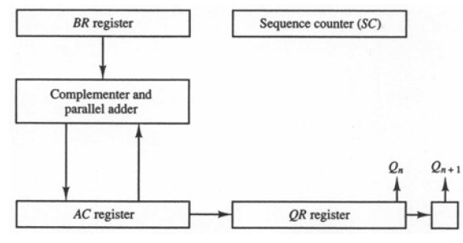
Description and Hardware for Booth Multiplication
QR multiplier
Q_{n} least significant bit of QR
Q_{n+1} previous least significant bit of QR
BR multiplicand
AC 0
SC number of bits in multiplier
Algorithm
Do SC times
Q_{n}Q_{n+1} = 10
AC ← AC + BR + 1
Q_{n}Q_{n+1} = 01
AC ← AC + BR
Arithmetic shift right AC& QR
SC ← SC – 1

Slide 16
Flowchart for Booth Multiplication
Multiply
Example: -9 × -13 = 117
BR = 10111, BR + 1 = 01001
Multiplicand in BR
Multiplier in QR
Comment
AC
QR
Q_{n+1}
SC
00000
10011
0
5
AC ← 0
Q_{n+1} ← 0
SC ← n
Subtract BR
01001
01001
Ashr
00100
11001
1
4
Ashr
00010
01100
1
3
= 10
= 01
10111
Q_{n}Q_{n+1}
Add BR
11001
AC ← AC + BR + 1
= 00
AC ← AC + BR
Ashr
11100
10110
0
2
= 11
Ashr
11110
01011
0
1
Subtract BR
01001
ashr (AC & QR)
SC ← SC – 1
00111
Ashr
00011
10101
1
0
≠ 0
= 0
SC
END

Slide 17
Exercise
Show the step by step multiplication process using Booth algorithm when the following binary numbers are multiplied. Assume 5-bit registers that hold signed numbers. The multiplicand in both cases is +15.
  (+15) × (+13)
  (+15) × (-13)

Slide 18
References
Text Book
M. M. Mano, Computer System Architecture, Prentice-Hall,2004

